Slide 1

Technology and Durables Semiconductors Value Company
Wiktor Bednarek

Slide 2
Agenda
Company Background
Sector outlook
Screening
Explanation of Financials
Ratios, Growth Rates, Balance Sheet
How does company fit into the portfolio and your price target
Recap/Questions

Slide 3
Company Background
Worldwide semidonductor producer
Advanced Micro Devices, Inc. was founded in 1969 and is headquartered in Santa Clara
Operates in Computing and Graphics; and Enterprise, Embedded and Semi-Custom. AMD RYZEN, EPYC, RADEON
AMD acquired ATI in 2006, it went to graphics industry
CEO: Lisa Su, since 2014; CFO: Devinder Kumar, since 1984; CTO: Mark D. Papermaster, since 2011
Sony and Microsoft: each accounted over 10% of sales
Top three customers accounted for approximately 16%, 12% and 7% of the total consolidated accounts receivable

Slide 4

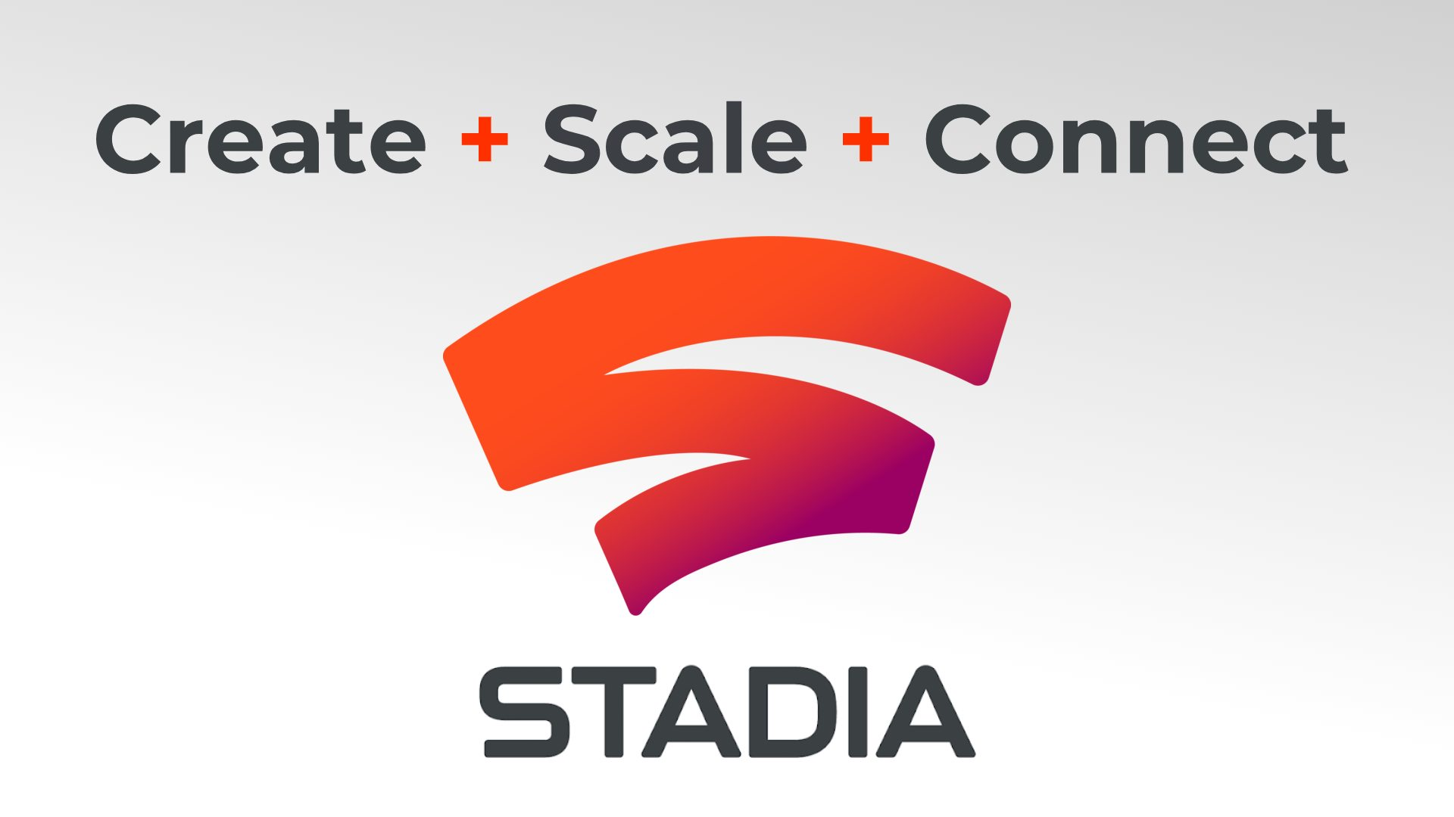

Sector outlook and AMD
General Semiconductors slowdown in 2019, range from 1.5% to
Long-Term growth due to the growing gaming industry, Machine learning and A.I., potential new cryptocurrency high, IOT, 5G and Big data
AMD PROSPECTIVE
New Ryzen 3000 processors in mid-2019, Mobile Ryzen Pro & Athlon Pro in current Quater, new Navi Graphics card 2019 (October)
After 6 years of loss in 2018 they achieved a profit
New significant customer Google with a cloud-based gaming platform
Selling twice more CPU units than Intel
Growing revenues and increasing net income in the 2019 and 2020

Slide 5
Screening
Company | Market Capitalization | Est. Annual Revenue Growth - 2 Yr % | Forward P/E | PEG Ratio
Advanced Micro Devices, Inc. | 29461.8 | 12.9 | 42.5 | 1.67
Broadcom Inc. | 120119.4 | 12.0 | 12.8 | 0.995
Intel Corporation | 248866.3 | 2.24 | 12.3 | 1.43
NVIDIA Corporation | 115163.6 | 7.86 | 35.3 | 3.27
Screening Criteria
1) Market Capitalization > 1000
2) Exchanges: All US Exchanges
3) Est. Annual Revenue Growth - 2 Yr % > 10
4) Industry Classifications: Semiconductors and Semiconductor Equipment (Primary)
5) Forward P/E < 100
6) PEG Ratio < 2

Slide 8


Model and assumptions
Model key assumptions
Market slows down
Less S&A expenses, later constant
Constant R&D
Target price
Base $30.91
Bear $15.51
Bull $42.02

Slide 9

Outlook and recommendation
Very good news and outlook of futures AMD’s products (Ryzen 3000, NAVI) and cooperations
Reliable and significant customers Microsoft, Sony and Google
Since past year AMD continues to dominate in CPU sells in consumer segment over Intel selling twice as many as Intel
FINAL VERCICT: BUY
(Current price $27,83, base target $30.91)

Slide 10
QUESTIONS?

